Slide 1
Final Projects
UNIV 101

Slide 2
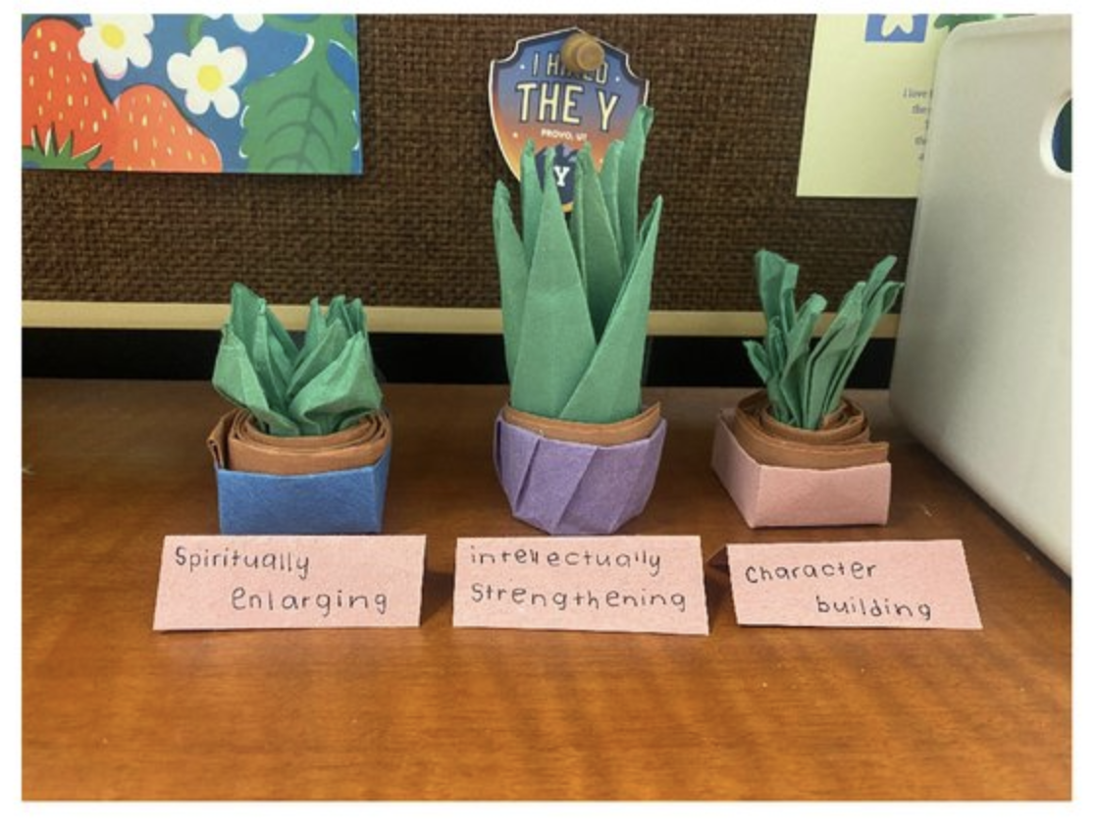
Origami

Slide 3

VIDEOS
https://www.youtube.com/shorts/muYonCSGhag

Slide 4
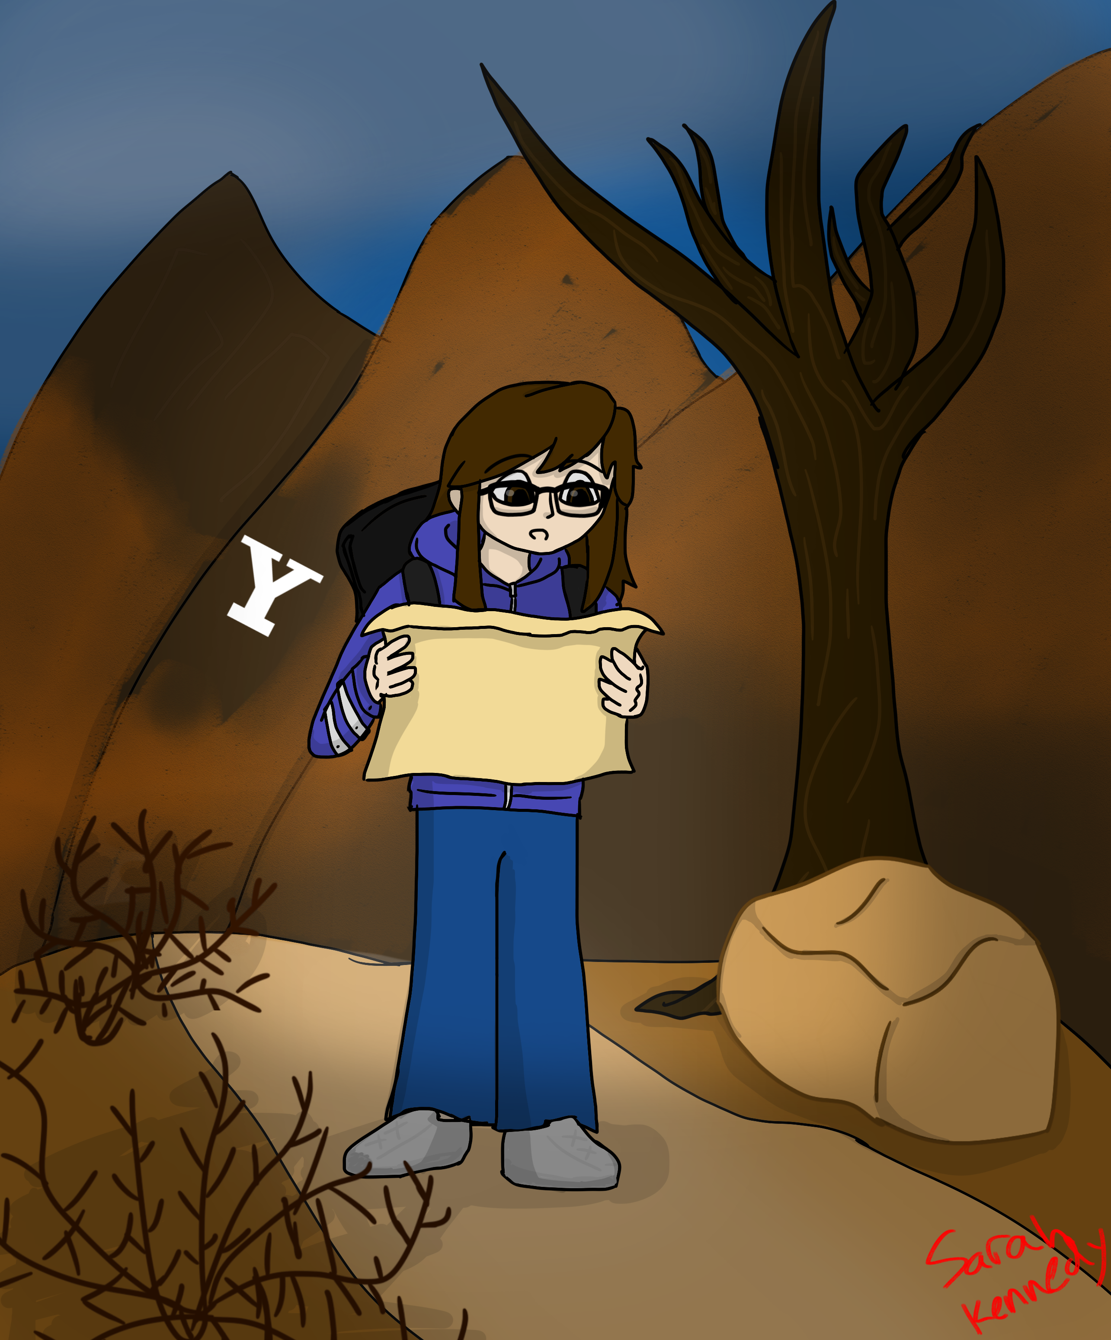
Paintings/Drawings

Slide 5
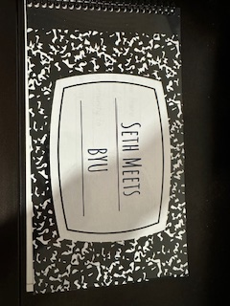
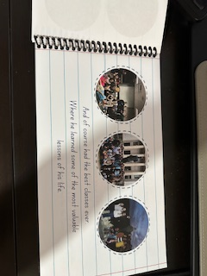
Story Books

Slide 6
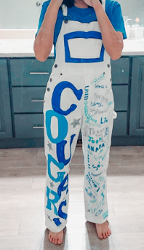
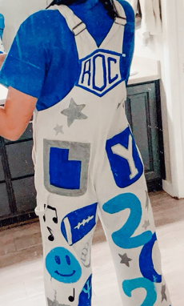
Overalls ☺

Slide 7
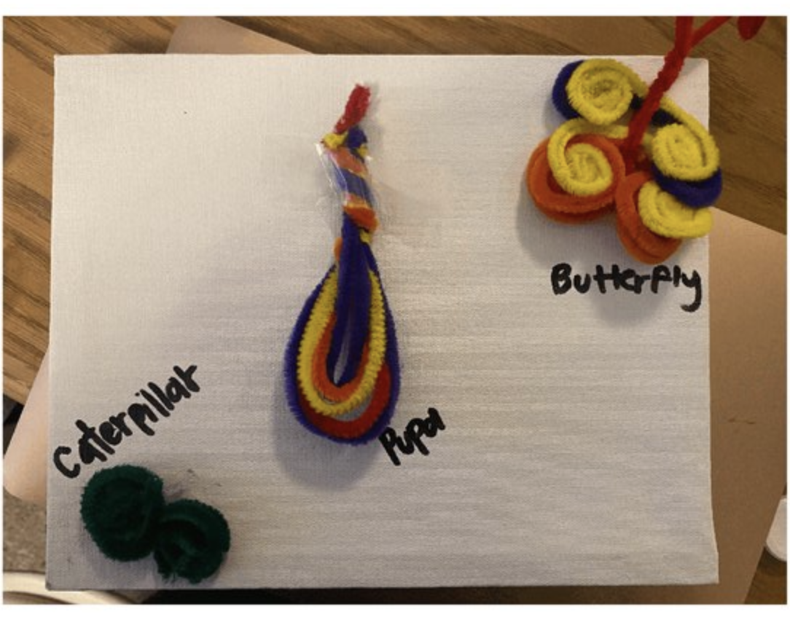
The Butterfly Cycle

Slide 8
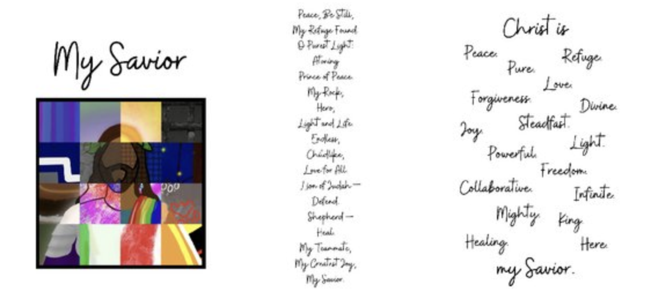
Digital Art & Poetry

Slide 9
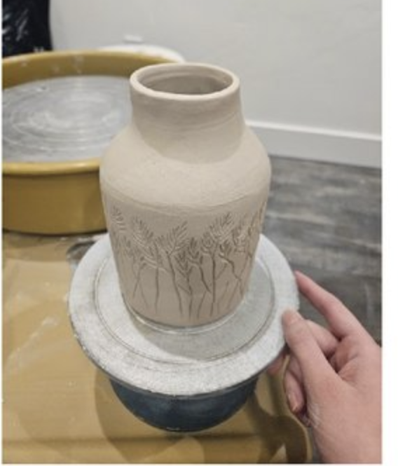
Pottery

Slide 10

How I attempted to make school a piece of cake
https://www.canva.com/design/DAF2uPt1oxY/63uvAmn4JXwI1fROFRLDUw/edit?utm_content=DAF2uPt1oxY&utm_campaign=designshare&utm_medium=link2&utm_source=sharebutton

Slide 11
Other Examples
Songs, poems, vision boards, collages, etc.
Please remember that the Creator’s Statement is really important in explaining your project. It is a chance to reflect on what it all means to you.

