Slide 1
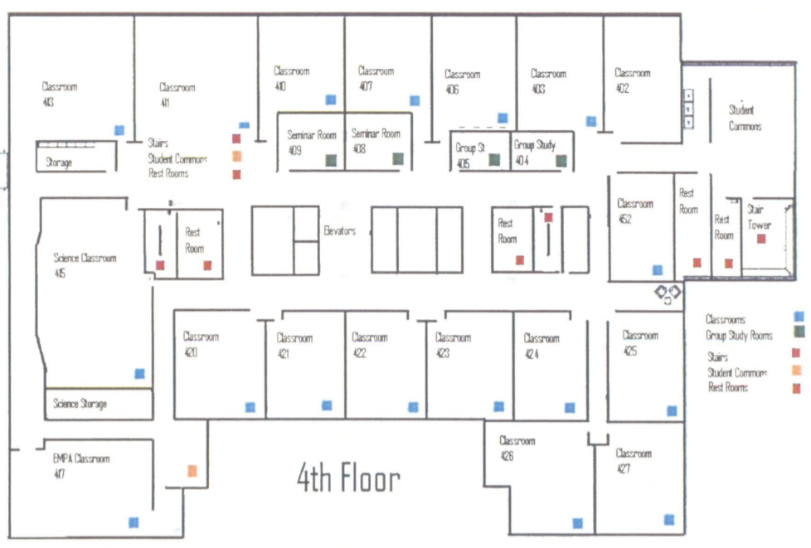
#1 Ind. 1 Firm A
414
#2 Ind. 1 Firm B
415
Main Classroom
416
#5 Ind. 1 Firm E
419
#3 Ind. 1 Firm C
417
#4 Ind. 1 Firm D
418

Slide 2
EMBA Class of 2027 Integrated StratSim Groups
Group Room Assignments
Industry 1 Firm A (Team #1) |  | Industry 1 Firm D (Team #4)
Room #414 |  | Room #418
Devin Andersen |  | Mitchell Clark
Jasen Mikels |  | Deric Holden
Andrea Richards |  | Mofan Li
 |  | Chase Robinson
Industry 1 Firm B (Team #2) |  | Industry 1 Firm E (Team #5)
Room #415 |  | Room #419
Joshua Butt |  | James Davis
Paulina Rich |  | Allen Doty
Timothy West |  | Gregory Hone
 |  | Marlon Sofoifa
Industry 1 Firm C (Team #3)
Room #417
Michael Cazanave
Joseph Garcia
Shawn Quigley

